Slide 1

Testing and Security
6. maj 2018

Slide 2
Agenda
Testing
Security

Slide 3

Testing

Slide 4
Why test?
Software contains defects, they hide themselves
Defects can cause software failures
Failures can cost money.
Even mortal…
Testing assures the quality of the software
Testing accelerates software development
Is debugging considered testing?

Slide 5
Famous software failures
Ariane-5
Took navigation software from Ariane-4, did not test.
Everything else was thoroughly tested
Ariane-5 had a different trajectory
When converting from 64bit float to 16bit unsigned int, got arithmetic overflow ☹
There was a exception handler, it was disabled ☹
Heartbleed
Heartbleed is an extension of TLS
It is used to keep Datagram TLS sessions open
Simple request/response scheme:
“Send me back the following (padded) string which is n bytes long…”
An attacker just had to request a long string, while telling it is short
Other party responded with a long string and potentially leaked confidential data

Slide 6
Do testing right
Testing has to be planned
Testing costs easily up to 40% of a projects budget
Testing has to be performed in a reasonable way
Testing shall be independent and objective
Testing has to be managed
Software testing is a fundamental part of professional software development!

Slide 7
What is Testing
The process consisting of all life-cycle activities, both static and dynamic, concerned with planning, preparation and evaluation of software products and related work products to determine that they satisfy specified requirements, to demonstrate that they are fit for purposes and to detect defects

Slide 8
What is testing (cont.)
Perspective | Objective
Developer | Find defects
Quality Assurance | Evaluate quality
Tester | Check functionality against requirements
Customer | Verify usability and applicability

Slide 9
What is requirements and specification?
The requirements document is the input to a development phase
The specification document is the output of a development phase
The specification document resulting from development phase X serves a requirements document for development phase X+1
Requirements and specification are the same, depending on the usage and point of view
The product is 100% specification

Slide 10
Validation and Verification

Slide 11
Validation
The process of evaluating a system or component during or at the end of the development process to determine whether it satisfies specified requirements
IEEE Std. 610.10-1990
“Are we building the right product?”

Slide 12
Verification
The process of evaluating a system or component to determine whether the system of a given development phase satisfies the conditions imposed at the start of that phase
IEEE Std. 610.10-1990
“Are we building the product right?”

Slide 13

Static testing

Slide 14
Static testing
Verification only
Never executes code
Find defects
Static analysis
Automated
Reviews
Manual examination
Too support

Slide 15
Statis analysis
Analyse code
Control flow
Data flow
Typical usecases
Syntax checking
Code smell detection
Coding standards compliance
Typical detected defects
Syntax violations
Unreachable code
Overly complicated constructs

Slide 16
Review
Different review types
Informal review
No formal process and therefore inexpensive
Walkthrough
Train colleagues and users, gain common understanding
Technical review
Documented, defined process, allows discussion
Inspection
Formal process, gain metrics

Slide 17
Review (cont.)
Success factors
Clear predefined objective
Defects found are welcomed and expressed objectively
Application of suitable review techniques
Management supports review process
Emphasis on learning and process improvement

Slide 18

Dynamic testing

Slide 19
Dynamic testing
Primarily verification
Executes code
Find failures
Different testing methods
Black box testing
White box testing
Different test levels
Unit (component, module) testing
Integration testing
System testing
Acceptance testing

Slide 20
Dynamic testing methods

Slide 21
Black-box testing
Specification-based testing
Test functionality by observing external behavior
No knowledge of internal workings
This is required!
Different approaches
Equivalence partitioning
Boundary value analysis
Decision table testing

Slide 22
White-box testing
Structure-based testing
Close examination of procedural level of detail
Knowledge of internals is required
Different approaches
Statement testing
Decision testing
(Multiple) Condition testing

Slide 23
Test levels

Slide 24
Unit Testing
Test individual units in isolation
Find defects in software components
e.g. functions, methods and classes
Done by developers
During development phase
Hopefully before implementing a given feature
This is considered white-box testing

Slide 25
Integration Testing
Test communication/interaction of units
I.e. their interfaces
Possibly separate unit integration and system integration tests
Done by developers
Primarily white-box tests, but black-box can also be done

Slide 26
System Testing
Test a complete integrated system
Evaluate system compliance with requirements
Stress, performance, usability, etc testing
Done by testers
Preferably external
In general black-box tests
White-box tests is possible but not common

Slide 27
Acceptance Testing
Test a complete integrated system
Evaluate system compliance with acceptance criteria
May be performed during development phase
Done by customers/users
Strictly black-box tests

Slide 28

Continuous Integration

Slide 29
Automated activities
Execute static code analysis
Execute unit tests and maybe check code coverage
Deploy to test environment
Execute integration tests
Benefits
Earlier detection and analysis of conflicting changes
Regular feedback on whether the code is working as intended
No big-bang deploy
Reduces repetitive manual testing activities

Slide 30

Testing in .NET

Slide 31
Unit testing in .NET Core
Create separate testing project
For each class in project, have a test class associated
In test classes create test methods for validating behavior in project
Each test method is based around Arrange, Act and Assert
Arrange
Initialize values, create fake (controllable) dependencies
Act
Run the system under test, technically the method under test
Assert
Check the return value or system status against expected criteria

Slide 32
Demo time :D

Slide 33
Never say: Unit tests, we do not have time for that! Likewise, unit tests is not an excuse to not check your work!

Slide 34
Unit test tools
For running and asserting
For back-end
MS Test, xUnit.net, Nunit, MbUnit, etc
For front-end
Jasmine, Chai, Jest, Qunit
For faking dependencies
For back-end
Moq, NSubstitue, MS Fakes, TypeMock, etc
For front-end
Jasmine, SinonJS, etc

Slide 35
Final points
For production code, unit testing is not a choice, it is a must!
Writing testable code is more important that frameworks and tools for testing
Maybe using code coverage as a metric
Code- and Test-review to keep quality high

Slide 36
Bonus: TDD
TDD → Test Driven Development
It is a software development process
It is an approach to design and develop testable code
It is based around short 5-step cycles
Start by writing tests based on specifications and failure conditions
Run unit tests and verify the fail
Implement the actual methods
Run tests again and confirm they pass
Refactor code (I.e. clean up code, remove duplicates etc.)

Slide 37
Exercise time
Grab the project from Code Examples called TestingExercise
Examine the project
Write unit tests for the home controller (A general example + controller test is provided)
Make sure to take into account the different ways thing can go wrong etc.

Slide 38

Security

Slide 39
Common web security vulnerabilities
Cross Site Scripting (XSS)
SQL Injection
Bad practices
Not using HTTPS
Broken authentication
Etc…

Slide 40
Reasons for vulnerabilities
Bad coding practices
Failure to properly validate input
Failure to sanitize input

Slide 41
How to handle user input
A talented attacker is able to change parts of our HTTP request.
I.e.
Cookies
Form Fields
Hidden fields
URL
Headers
Therefore validation/sanitation of input should happen on both Client and Server

Slide 42
Cross site Scripting (XSS)
A security exploit where the attacker inserts malicious client-side code into a webpage
It has been around since the 1990s
Most major websites have been affected by XSS at some point
Including Google, Yahoo and Facebook

Slide 43
Cross site Scripting (XSS) (cont.)
Preventing XSS attacks via:
Filtering
Input validation and output sanitization
Use a safer browser
Pay more attention when using shortened URLs
Content Security Policies
Prevent this ☺

Slide 44
SQL Injection
SQL Injection is a technique where malicious users can inject SQL commands into an SQL statements via:
URLs
Input parameters
Cookies
Headers
Etc.
SQL injection is a very old approach but is still popular

Slide 45
Mitigating risks
Validate input
Escape user input
Least privilege
Use prepared statements
Code reviews
Salt and hash passwords

Slide 46
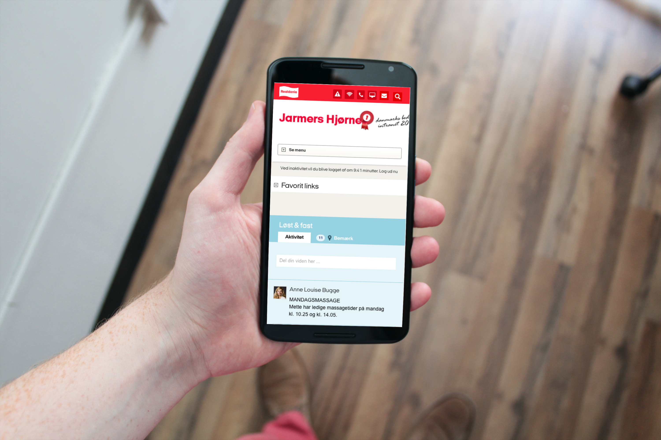
Questions?

Slide 47
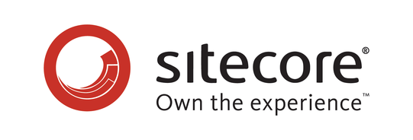
Brugbare elementer
Dobbeltklik for at ændre farve eller indsætte baggrundsbillede

